Slide 1

Around environment:
Oil consumption and its consequences
Sofian EON
Arthur MURILLO

Slide 2
Table of contents
What is oil production today?
How dangerous is it everyday?
What alternatives are there?

Slide 3
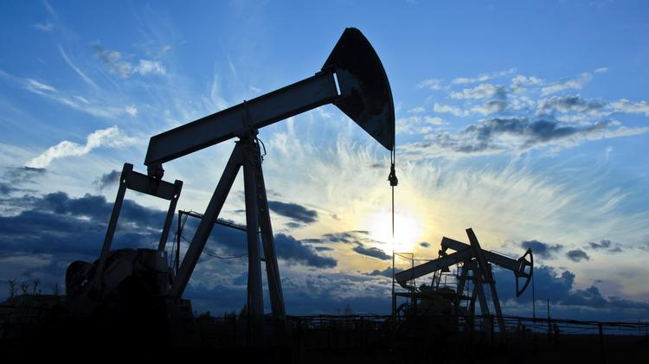
What is oil production today?
Numbers :
14.85 million barrels produced / day in 2016.
19.53 million barrels consumed / day in 2016.
In 2018: 11 204 976 tons produced.

Slide 4
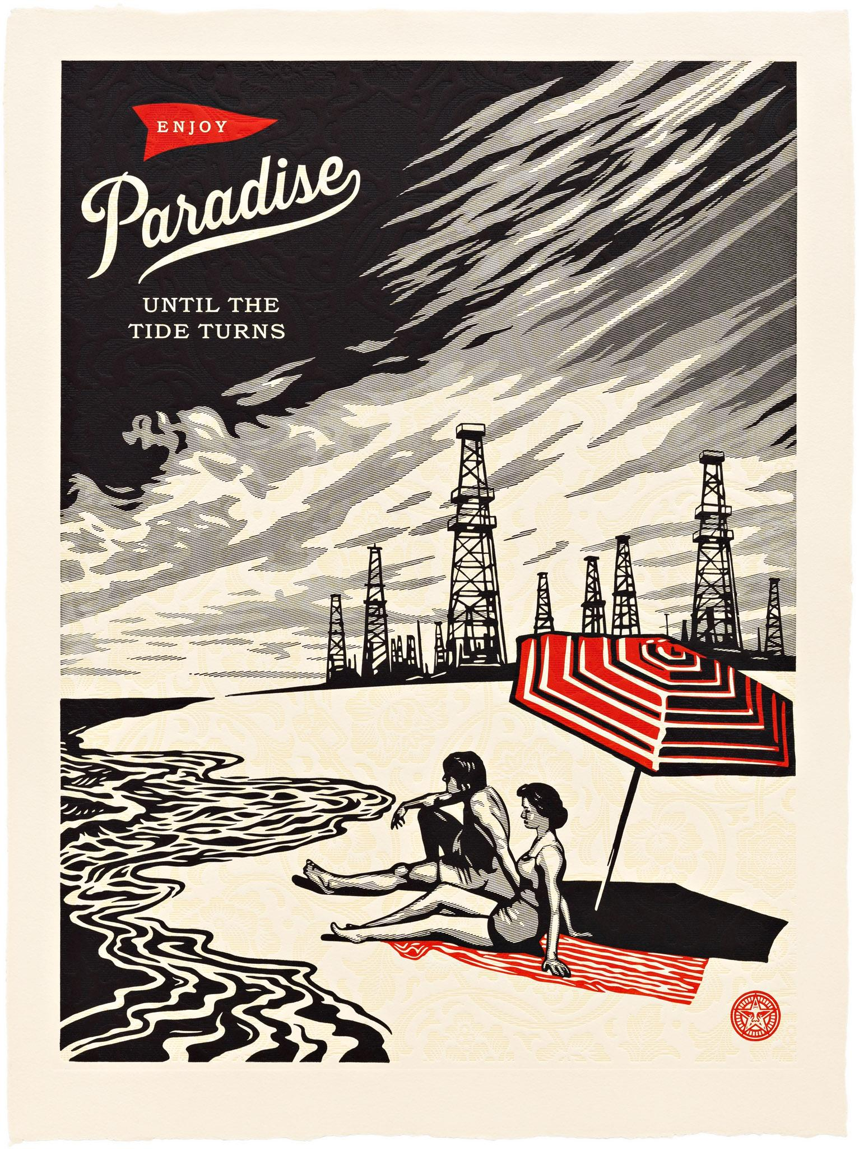

Slide 5
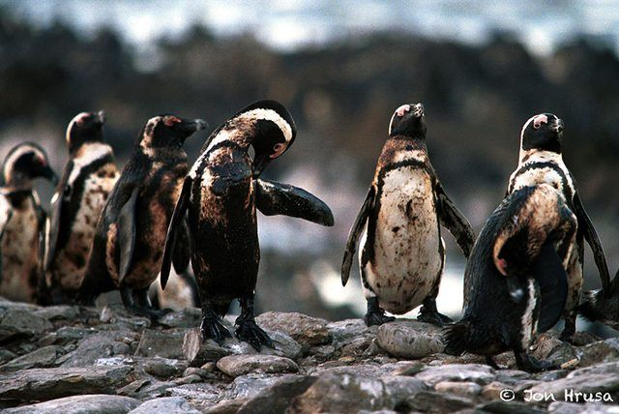
How dangerous is it everyday?

Slide 6


What alternatives are there?

Slide 7
Thank you for listening!
If you have any questions, go for it!

